Slide 1
iSchool Assembly
May 6, 2022

Slide 2
Agenda
Call to order
Review and approval of minutes from April 3rd meeting
Review and approval of this agenda
Dean's Update [Keith]
UHR Awards [Keith]
MPS in Accessibility Studies [Ron & Paul]
Professional Doctorate - Doctor of Inclusive Leadership in Information Organization [Paul]
Nominating Committee voting on service roles [Katy L]
Development Update [Nancy]
College Advisory Committee presentation [Rochelle/Andy]
Commencement Reminders [Sarah G]
Announcements

Slide 3
Dean’s Update
Dean Marzullo

Slide 4
UHR Awards
Dean Marzullo

Slide 5
MPS in Accessibility Studies
Ron

Slide 6
Who are we designing for?

Slide 7
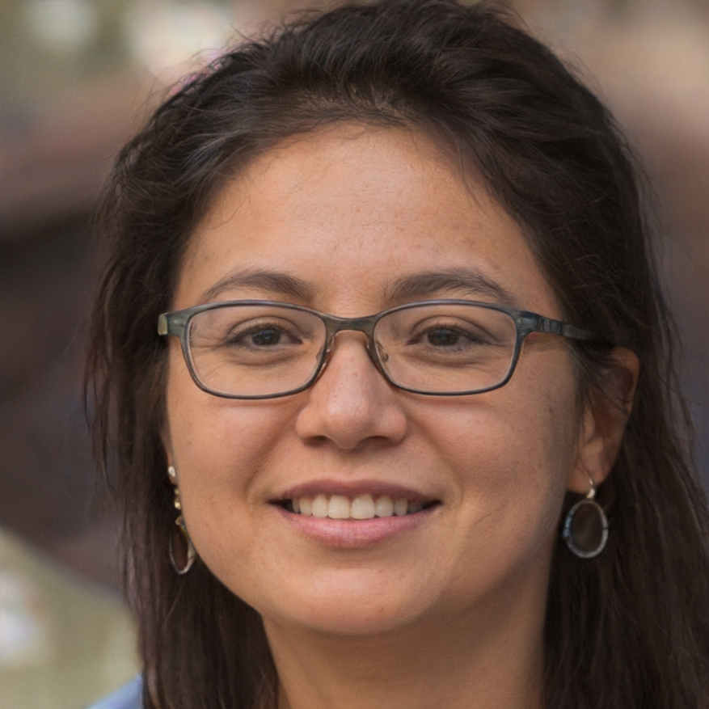
Elizabeth Sharma, 32
Elizabeth became interested in disability rights in college
She has been working for an advocacy nonprofit since graduating law school
She would like to move into a policy position at a government agency
She is well-versed in the legal side of accessibility, but wants to learn more about the business side of making accessible environments
https://thispersondoesnotexist.com

Slide 8
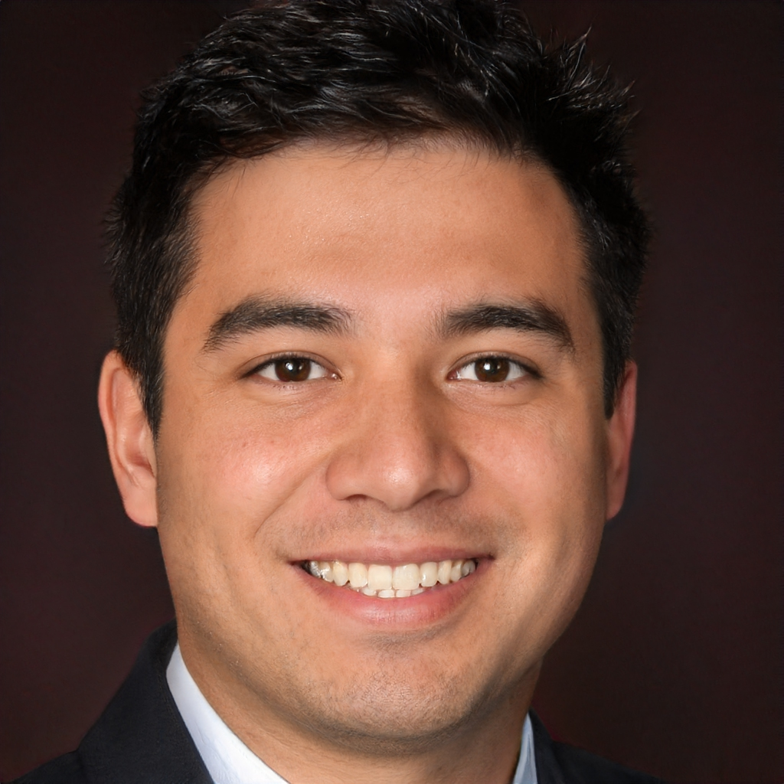
Ruben Orantes, 27
Ruben is a software developer at a mid-sized company. He started off as a backend programmer, but through on-the-job and spare-time learning he has become a full-stack web developer.
He knows the basics of usability testing and UX design, but he wants to learn more about design for accessibility
He has a visual impairment and wants to learn about accessibility beyond his own personal context
Within the next few years, he wants to move into a leadership role and advocate for better accessibility practices in software development
https://thispersondoesnotexist.com

Slide 9
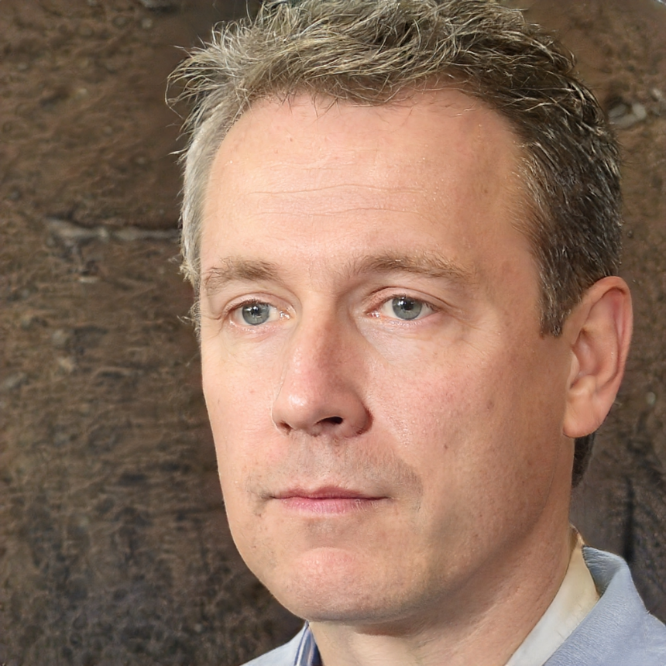
Tom Parker, 38
A computer nerd in high school, Tom started off in corporate IT and then moved to a government position a few years ago
Accessibility is taken much more seriously at his new workplace, and while Tom has learned a lot on the job, he wants to make sure he has a thorough understanding of Section 508 requirements
He sees more opportunities for advancement if he can gain a more strategic, policy perspective instead of focusing on implementation
https://thispersondoesnotexist.com

Slide 10
The Big Picture
What is accessibility studies?
TRACE
Including Disability
Journal
Global Summit
Accessibility Learning Lab

Slide 11
Learning Outcomes
Describe and analyze social and technical root causes of inaccessibility, “design for difference” processes, and broader sources of discrimination faced by individuals and groups from a spectrum of abilities. Describe historical and contemporary roles of digital and physical products and environments in shaping social inclusion/exclusion of disabled peoples. Analyze the intersection of accessibility and disability, with a focus on a spectrum of abilities and cultural and linguistic diversity. Apply relevant state, national, and international laws, policies, and treaties related to accessibility of information and technology as well as their relationships to broader disability rights laws, policies, and treaties. Describe and analyze the history of assistive technology devices for people with different types of disabilities - sensory, motor, cognitive, language, cultural, and learning disabilities - and the use of those devices. | Analyze and implement best practices and methods for designing technologies to be fully inclusive for a broad population of users. Develop new ways to incorporate disabled users into design and development processes, such as prototyping and usability testing. Describe and apply testing methods for individual assistive technologies and to ensure universal usability. Describe and apply procurement processes and management strategies for acquiring and implementing accessible products. Develop and implement advocacy strategies for promoting accessibility in policy contexts.

Slide 12
MPS Structure
Common foundation: disability and accessibility studies
Two tracks: technical and policy
Leadership development: beyond compliance

Slide 13
Interested in helping? What classes would you like to see? What skills or competencies should be prioritized? Interested in joining the committee?

Slide 14
Professional Doctorate - Doctor of Inclusive Leadership in Information Organization
Paul and Beth St. Jean

Slide 15
Doctor of Inclusive Leadership for Information Organizations (ProfD)
A New iSchool Degree Program

Slide 16
What needs will it address?
Interactions between JEDI and information in applied settings
Degree beyond the master’s level that isn’t research-focused
Clear career path toward leadership roles in many information organizations
Diversity in information workforce, especially at the leadership level
Inclusion and equity within organizations; in the services, products, technologies; and within the communities that they serve

Slide 17
Why us?
Literally people, information, and technology for good
Strength in JEDI that dates back to College’s founding
Social justice legacy of librarianship connects the urgencies of now across information organizations
Encompasses interdisciplinary expertise of dozens of full-time faculty and staff members
Nothing like this exists at another iSchool or anywhere else

Slide 18
Who is it for?
Open to anyone with an information-related master’s degree – MLIS, MIM, MIS, HCIM, etc – or another kind of master’s, such as an MPH, MSW, or MEd
Key criteria is having the professional goal of being a leader in an information organization, which can be anything from GLAM to a higher education unit to a government agency to a community non-profit – the people, information, and technology for the good nexus

Slide 19
Program Goal and Learning Outcomes
Program goal: Prepare students to articulate and apply JEDI principles within information organizations and communities, using a diverse and comprehensive methodological tool box, and fostering and sustaining inclusive and equitable processes
Program-level learning outcomes:
Articulate important JEDI issues and apply the knowledge to institutions;
Articulate the organizational values of diversity and social justice;
Produce organizational management deliverables, ensuring universal usability;
Conduct successful, JEDI-focused budgeting, fundraising, and human resources management for organizations;
Apply advocacy skills to make positive change and build support for the application of JEDI concepts within real-world organizations and externally.

Slide 20
Curriculum
Nine 3-credit hour content courses (eight of which are newly developed) and a 6-credit capstone project, studying and applying what they have learned to solve problems in an institution
Courses will be open to all graduate students in the College as well, in order to supplement current course offerings in other programs

Slide 21
Courses, Part 1
Existing course being upcycled:
INST 622 Information and Universal Usability
New courses with completed syllabi:
INST812 Equitable Financial Management for Information Organizations
INST850 Leading an Inclusive and Equitable Information Organization
INST851 Engagement and Outreach to Diverse Communities Served by Information Organizations
INST853 Building Success while Promoting Justice in Information Organizations

Slide 22
Courses, Part 2
Course syllabi still being developed:
INST805 Leveraging Data for Transformational Organizational and Social Change
INST806 Program Assessment and Evaluation in Information Organizations
INST807 Participatory Design and Participatory Action Research in Information Organizations
INST830 Equitable Human Resource, Management, and Evaluation Processes in Information Organizations

Slide 23
Path Forward
August 2022: Complete program proposal
September: Present for a vote at iSchool Assembly
October: Submit to Grad PCC (campus-level) - hopefully a vote then, but we might not make the first meeting
November: If there is a positive vote at Grad PCC, submit to Campus PCC
December: If there is a positive vote at Campus PCC, submit to MHEC
February-March 2023: Presentation to MHEC
April-May: If there is a positive vote at MHEC, this is administrative time to get all the signatures and such, going up to the Chancellor

Slide 24
Brought to you by
The committee:
Jason Aston
Andy Fellows
Dennis Frezzo
Renee Hill
Kate Izsak
Paul Jaeger
Allison Jennings-Roche
Ryan O’Grady
Beth St. Jean
Jeff Waters
Suzy Wilson
With assistance from:
Beth Bonsignore
Tammy Clegg
Vedat Diker
Pam Duffy
Kibbi Henderson
Eric Hung
Mega Subramaniam
The letter K and the number 7…

Slide 25
College Advisory Committee
Presentation
Rochelle and Andrew

Slide 26
College Advisory Committee
The Committee shall consult, at least once a semester, with the Dean on matters of interest and concern to the College, including decisions regarding budgets and facility planning.
The Committee shall report at least once a semester to the College Assembly.
The College Advisory Committee shall serve as the Committee on Committees and shall propose a slate of candidates from which the Dean may appoint members to Administrative Committees, and shall provide a slate of candidates from within the College from which administrators above the College level may appoint representatives to participate in the search, nomination, and review of the Dean of the College.

Slide 27
College Advisory Committee
Tenure-Track/Tenured faculty
one Full Professor : JONATHAN LAZAR
one Associate Professor: KARI KRAUS
one Assistant Professor: CARO WILLIAMS-PIERCE
Professional Track faculty
one from the Research track: BETH BONSIGNORE
one from the Teaching/Instructional track: DONAL HEIDENBLAD
one from the Faculty Specialist tracks: ANDY FELLOWS
Staff: SARAH GRUN & ROCHELLE ROBINSON

Slide 28
College Advisory Committee
OCTOBER 29, 2021
Enhancing the Research Enterprise presentation by Keith Marzullo
Report from the Cabinet and Deans retreat - Keith Marzullo
DECEMBER 6, 2021
Adding Student Representation to CAC
Presentation to Provost
Upcoming Facilities Projects
Increase GSR rates for Graduate Students

Slide 29
College Advisory Committee
FEBRUARY 3, 2021
iSchool FY22 Mid-Year Core Budget Review by Melekte Truneh
Facilities
Maryland Bonus, COLA, and Merit
Telework Policy
College of Information Studies Review Mandated by USM
MARCH 7, 2021
Adding Meeting Notes on Internal Website
Reviewed CAC Charge and Purpose
Evaluate how this year went and how to improve next year
How to get more feedback from Faculty and Staff

Slide 30
College Advisory Committee
APRIL 7, 2022
InfoSci Program Update Presentation (Vedat Diker)
Undergraduate Demographics
Maryland Day (Sarah Grun)
Presenting at May Assembly
May 2, 2022
No Meeting

Slide 31
Thank You to 2021-2022 CAC Members
Andrew Mackenzie Fellows
Brian Butler
Caro Williams-Pierce
Donal Heidenblad
Elizabeth Marie Bonsignore
Jess Feltner
Joan Olive Cole
Jonathan K Lazar
Kari Kraus
Katherine Worboys Izsak
Keith Ansel Marzullo
LaVida Beveney
Mega Subramaniam
Melekte Y. Truneh
Rochelle Robinson
Sarah Grun
Susan J Winter

Slide 32
College Advisory Committee
GET INVOLVED!
Have questions, concerns, ideas that you want to share with the iSchool?
Want to get feedback on your own committee’s work-in-progress?
Want to make sure the iSchool knows what your committee is working on?
Contact us at ischoolcac@umd.edu

Slide 33
Nominating Committee Voting on Service Roles
Katy Lawley

Slide 34
iSchool Service Elections
Nominating Committee: Fabian, Renee, Katy, Katie

Slide 35
Ballot 1: Assembly Officers
Position | Nominee | Term Details
Assembly Chair | Fabian Faccio | Never served
Assembly Secretary | Neil Dhingra | Never served
Assembly Parliamentarian | Amanda Lazar | Incumbent with 3 years served, no term limit
Nominees from the floor?

Slide 36
Time to Vote for Assembly Officers:

Slide 37
Ballot 2: APT Officers
Position | Nominee | Term Details
APT Co-chair (TTK) | Jen Golbeck | Incumbent with 1 year served, no term limit
APT Co-chair (PTK) | Kathy Weaver | Incumbent with 4 years served, no term limit
Nominees from the floor?

Slide 38
Time to Vote for APT Officers:

Slide 39
Graduate Council
Position | Nominee | Term Details
Graduate Council | Eun Kyoung Choe | Never served
Nominees from the floor?

Slide 40
Time to Vote for Graduate Council:

Slide 41
College Advisory Committee
Position | Incumbent (not nominee) | Term Details
TTK - Assistant Professor | None
TTK - Associate Professor | None
TTK - Full Professor | None
PTK - Instructional | Donal Heidenblad | 1 year served
PTK - Faculty Specialist | Andy Fellows | 2 years served
PTK - Research | Beth Bonsignore | 2 years served
Staff - Non-voting | Rochelle Robinson | 2 years served
Staff - Voting | Sarah Grun | 1 year served
Discussion / statements of interest?

Slide 42
College Advisory Committee:
Time to Vote!

Slide 43
Development Update
Nancy Murray

Slide 44
Dollars raised
to date:
$731,312
(As of 5/3/2022)
250 Donors

Slide 45
Commencement Reminders
Sarah Grun

Slide 46
Announcements
Lunch in Hornbake basement room 0300
The APT meeting will begin at 1pm in ESJ-2208.

