Slide 1
iSchool College Assembly October 2, 2015

Slide 2
MLS Name Change
Proposed Motion:
The College Assembly approves the proposal to change the name of the Masters of Library Science (MLS) to the Masters of Library and Information Science (MLIS).

Slide 3
Two Questions
Where are we going?
How will we get there?

Slide 4
Where are we going?
Goal: Top 10 Public University
Affordable and Accessible Education
Research Excellence
Global Climate Change
Cybersecurity
Big Data
Virtual Reality/Augmented Reality
Contemporary African-American Experience
Brain Behavior Initiative
Sports medicine and human performance
Imagination and Innovation
Maryland Pride

Slide 5
How will we get there?
Estimated cost: $2 Billion
$1 Billion in capital
$1 Billion in operating revenue
Increasing the endowment
2-3 times (~$500 million to ~$1.5 billion)
Increasing operating revenue
50% (~$1.9 billion to $~3 billion)

Slide 6
How will we get there?
Philanthropy
$200+ Million in 2015FY
Entrepreneurial programs
Partnerships
Research Funding
$550 Million in 2015FY
Efficiencies

Slide 7
Where are we? (iSchool Revenues)
 | 2014FY | 2015FY
Base Allocation | $3.2 million | $3.4 million
Entrepreneurial Programs | $1.9 million | $2. million
Philanthrophy and Awards | $.6 million | $.4 million
Research Grants | $2.6 million | $3.8 million
Other | $.8 million | $.5 million
TOTAL | $9.1 million | $10.1 million

Slide 8
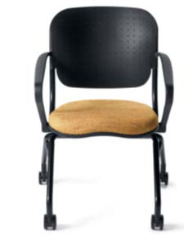
“Endowing a Chair” @ the iSchool
$300 gift (or $25 / month)
Holistic support for iSchool students
New classroom chair
$50 to scholarship fund of your choice
Named chair
Campaign goal:
100 new chairs

Slide 9
Communicating What We Do
Discover New Knowledge (#UMDdiscovers)
August - October
Inspire Maryland Pride
November - January
Transform the Student Experience
February - April
Turn Imagination into Innovation
May - July

Slide 10
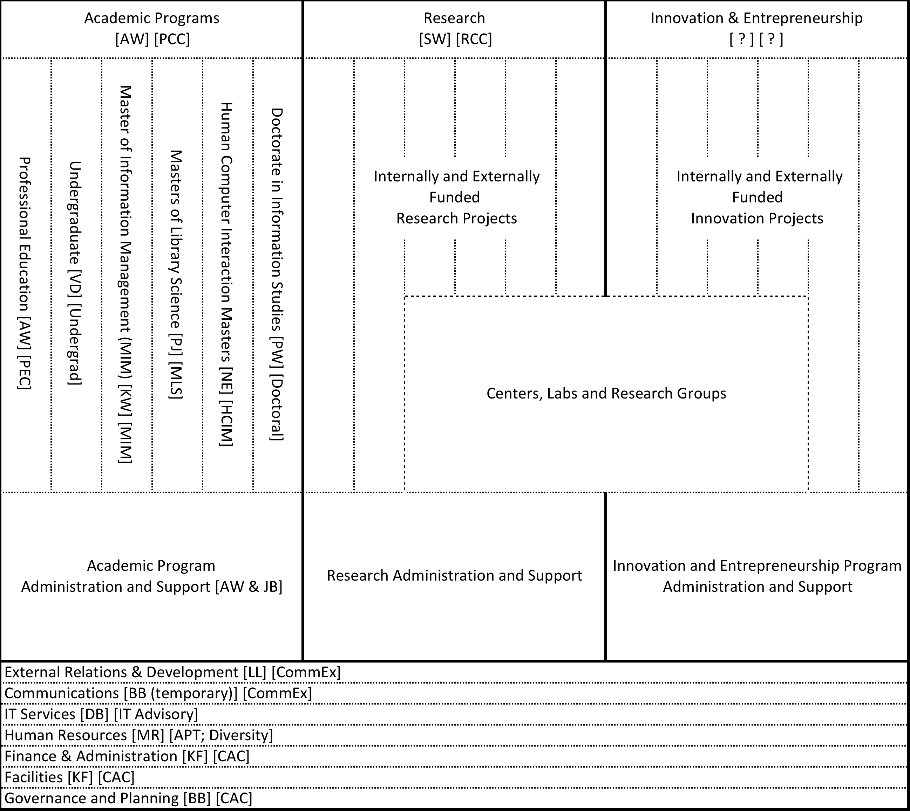

Slide 11
Dean’s Update
Academic Programs (Ann Weeks)
Student Services – Graduate Advisor hire in process
Research & Research Support (Susan Winter)
Innovation, Entrepreneurship and Engagement
New Director, Tim Summers
Facilities (Kathleen Fominaya)
Hornbake North build out and Hornbake South Updating in planning stages
Finances (Kathleen Fominaya)
2015FY budget under development

Slide 12
Dean’s Update
Communications
New Communications Coordinator (Johnna Percell)
Media Monitoring
Personnel (Maggie Rodriguez)
New People
Tim Summers
Johnna Percell
Tenure track hires in process
Professional track hires planned
IT Services (David Baugh)
Desktop Support hire in process

Slide 13
Dean’s Update
External Relations & Development (Larry Liff)
Governance and Planning
College Advisory Committee
Emerging Strategic Initiatives
College Review (Fall 2016)

Slide 14
College Review
“Periodic review of an academic unit's pursuit of excellence can contribute significantly to the enhancement of the unit's progress and respond to the University's responsibility for efficient use of resources. Each academic unit on campus shall undergo a review at no more than seven-year intervals. Centers contained within a unit shall be reviewed along with the unit. “
http://www.president.umd.edu/policies/2014-i-600a.html

Slide 15
Long Term Goals
Academic Programs
Doctoral
Masters (HCIM, MLS, MIM)
Undergraduate
Professional Education
Research
Innovation, Entrepreneurship, and Engagement (IEE)

Slide 16
Long Term Goals
Performance at Scale
What does competence performance accomplish?
Excellence
What does exemplary performance accomplish (that is different than competent performance)?

Slide 17
Long Term Goals
What are we trying to accomplish with this effort & how can we tell if we are accomplishing that?

