Slide 1
Patuxent Building Walkthrough
https://youtu.be/cPbQyUp0ALY
(Thanks to Craig T. and Diane T. for putting this together)

Slide 2
iSchool Space
Hornbake South - 2nd floor | 10339 sq ft
Hornbake South - 4th Floor | 11230 sq ft
Hornbake North | 4376 sq ft
Hornbake Total | 25945 sq ft
Patuxent - 1st Floor (Goal: August 2018) | 7020 sq ft
Patuxent - 2nd Floor (Goal: Mid-Fall 2018) | 7020 sq ft

Slide 3
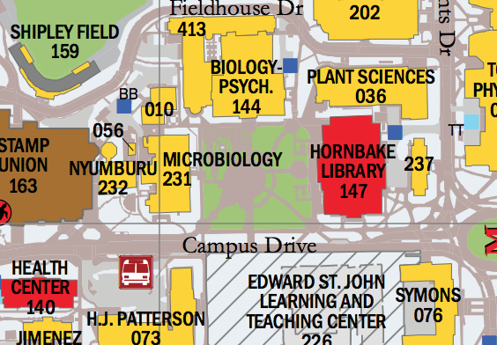
Patuxent Building

Slide 4
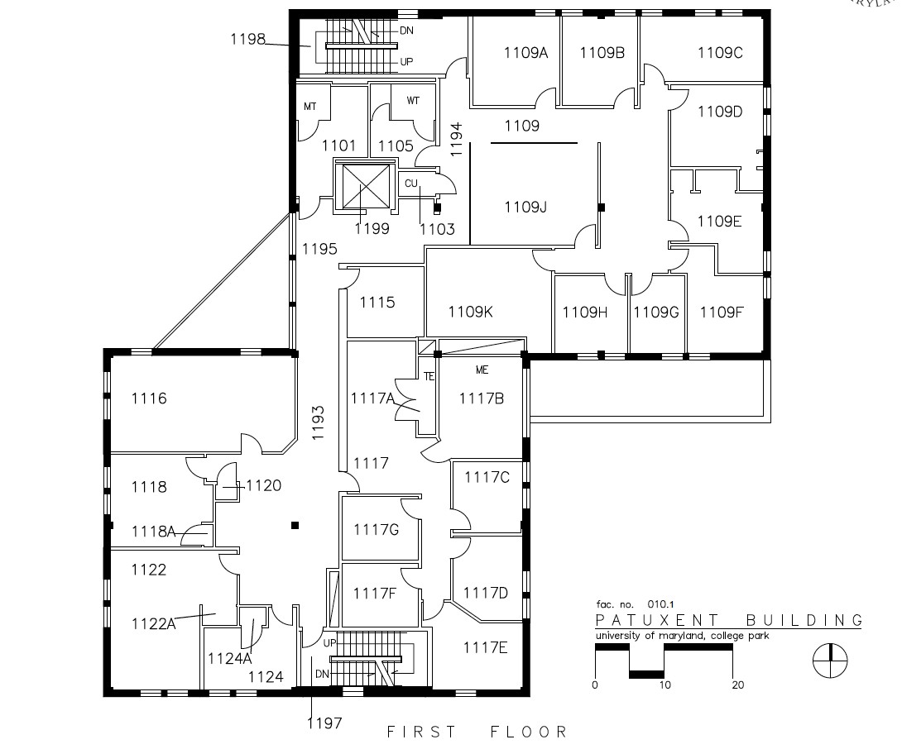
Patuxent – 1st Floor

Slide 5
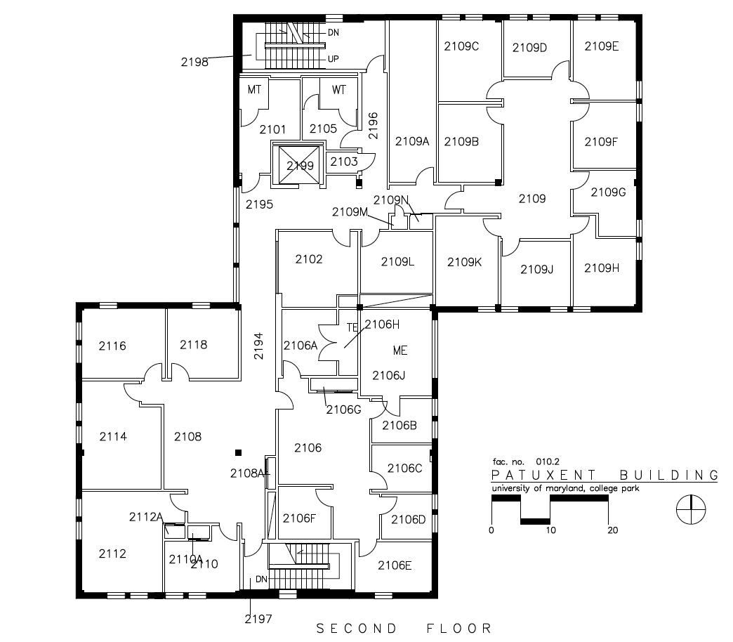
Patuxent – 2nd Floor

Slide 6
Next Steps
Facilities/Tour Sessions:
Friday, May 4th
May 7 – 18 (times to be determined)
Specific proposals to be considered:
Moving the Dean’s office/Admin offices
Reorganizing/Moving Academic Program offices
Creation of 2-3 research/teaching clusters
Creation of 1-2 collaboration/design spaces
Others….(proposals welcome)
Timelines:
May 18 – Patuxent 1st Floor moving plans
May 30 – Patuxent 2nd Floor, Hornbake moves planned

