Slide 1
iSchool Assembly
September 4, 2020

Slide 2
Agenda
Call to order
Review and approval of minutes from Friday, May 1 2020 meeting
Review and approval of this agenda
Dean's Update [Keith]
Introduction: Brooke Fisher, ADVANCE Professor
Shady Grove Undergraduate Minor [Galina/Tetyana]
Journalism/iSchool “data journalism” professional master’s program [David]
Social Data Science Center at UMD (SoDa) Launch [Brian/Katie]
Future of Work @ the iSchool Working Group Updates [Sarah]
Summer anti-racist efforts in iSchool [Bill]
WAYWO: What are You Working On [Sarah/Katrina]
Announcements

Slide 3
Dean's Update
Keith Marzullo

Slide 4
Introduction: ADVANCE Professor
Brooke Fisher

Slide 5
Shady Grove Undergraduate Minor
Galina/Tetyana

Slide 6
1. Risk Management, Ethics and Privacy
Focuses on the need to understand and address emerging and existing threads organizations deal with within the information domain and to gain deeper understanding of risk management, information security, data ethics and privacy.
5 courses (15 credits)
Managing Risk in the Information Age (new course) – 3 cr.
Emerging Technologies and Risk Assessment (new course) – 3 cr.
Information Assurance (new course) – 3 cr.
Project Management for Information Science (existing course) – 3 cr.
Human-Centered Cybersecurity (existing course) – 3 cr.

Slide 7
2. Technology Innovation & Social Entrepreneurship
Focuses on the social impact Information, People, and Technologies create while working together and interacting with each other; discovers different ways Social Entrepreneurs strategically use innovative technologies and information to solve social, cultural, and environmental issues; teaches students to successfully lead, create, and discover while sustaining the culture of innovation in their organizations and teams.
5 courses (15 credits)
REQUIRED:
Technology Innovation and Entrepreneurship (new course) – 3 cr.
Strategic Marketing for Entrepreneurs (new course) – 3 cr.
The Technology Socialpreneuer (new course) – 3 cr.
Leading and Sustaining a Culture of Innovation (new course) – 3 cr.
ELECTIVES:
Lean Startup in IT (new course) – 3 cr.
Project Management for Information Science (existing course) – 3 cr.
Competitive Business Intelligence (existing course) – 3 cr.

Slide 8
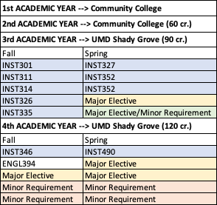
InfoSci Shady Grove 2-year Course Plan

Slide 9
Comments & Suggestions
Minor Names
Coursework
Courses already listed that do fit minor’s focus area
Courses that are not listed but are important to include
Interest in working with us on developing courses
InfoSci Shady Grove Minors Google Sheet

Slide 10
Master of Professional Studies Data Journalism
David Loshin
iSchool MIM
Derivative & Cross-Disciplinary Programs

Slide 11
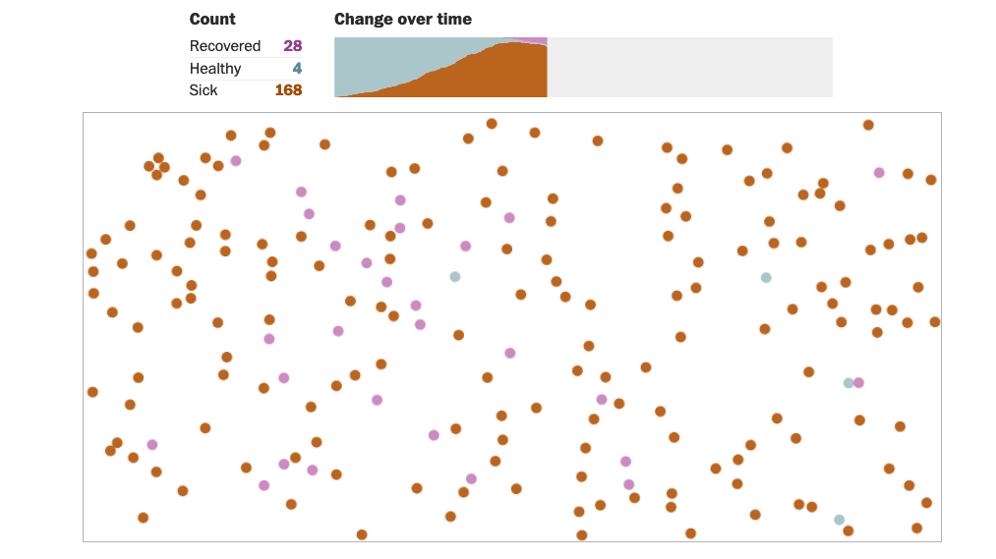
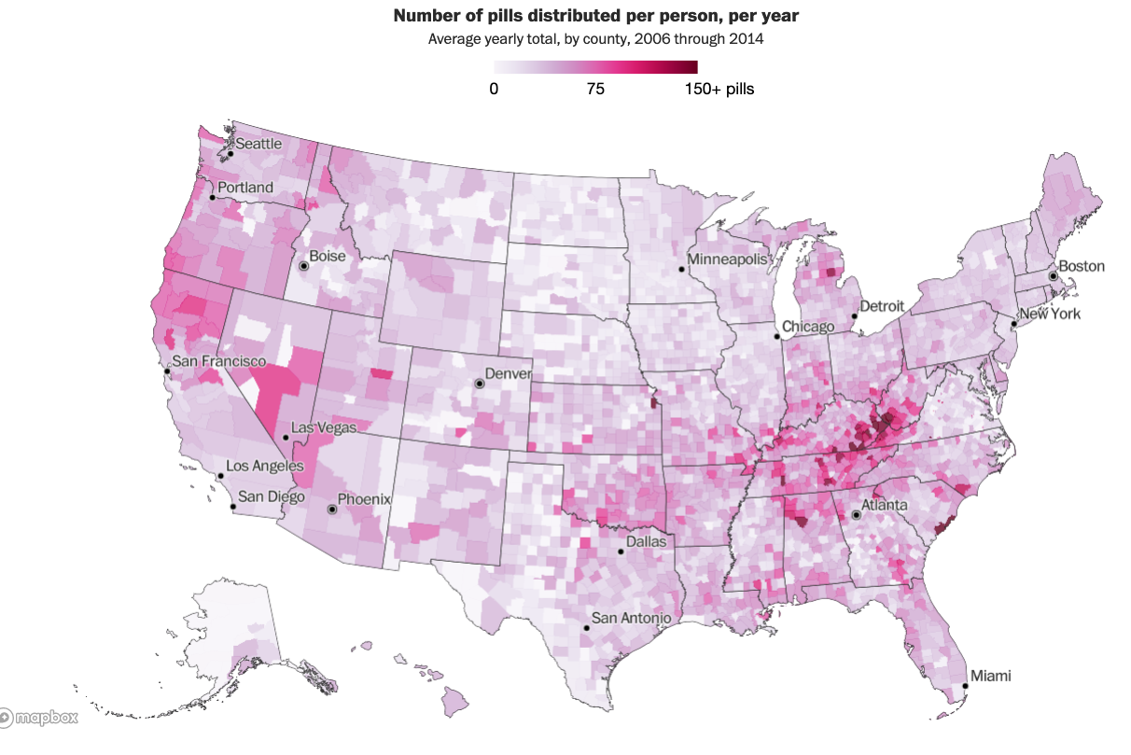
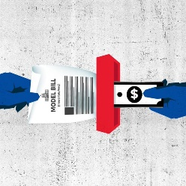
Increasing Adoption of Data Journalism
Washington Post Visualization of COVID transmission
USA TODAY, The Center for Public Integrity, The Arizona Republic
Project description: Copy, Paste, Legislate marks the first time a news organization detailed how deeply legislation enacted into law at the state level is influenced by special interests in a practice known as "model legislation." The series explained how model legislation was used by auto dealers to sell recalled used cars; by anti-abortion advocates to push further restrictions; by far-right groups to advocate for what some called government-sanctioned Islamophobia to moves by the Catholic Church to limit their exposure to past child abuse claims. (Published February 6, April 3, May 23, June 19, July 17 and October 2, 2019)
Washington Post ARCOS Opioid prescription data

Slide 12
MPS Data Journalism
Specially crafted cross-disciplinary program that blends Information Management and Journalism skills
Partnership between iSchool and Philip Merrill College of Journalism
Leverages the insight and skills of our own joint appointee Naeemul Hassan
Prepares graduates to leverage techniques and skills in
Open data, public data, FOIA requests, and otherwise acquired data
Data analytics, data science, Machine Learning/AI
Data visualization
Investigative reporting
to develop and visualize data-driven stories

Slide 13
Data Journalism MPS Graduates Will…
Data Journalism
Evaluate open, public, and other data sets
Collect, process, and assess data to identify relevance
Develop infrastructure for managing collected information
Apply data analysis and data science techniques
Employ tools and practices for data preparation
Develop reports and visual representations
Produce stories for dissemination

Slide 14
Proposed Program Curriculum
2 Year, fully online 30 Credit plan
JOUR652: Interactive Design and Development (3)
JOUR702: Journalism Law and Media Ethics (3)
JOUR772: Data Journalism (3)
JOUR779B: Computational Journalism (3)
INFM600: Information Environments (3)
INST627: Data Analytics for Information Professionals (3)
INST737: Introduction to Data Science (3)
INST750: Advanced Data Science (3) or INST754 Data Preparation
JOUR625: Advanced Capital News Bureau (6)
Summer 1 | Fall 1 | Spring 1 | Fall 2 | Spring 2
JOUR501: Fundamentals of Writing and Editing | INFM600: Information Environments | JOUR652: Interactive Design and Development | JOUR702: Journalism Law and Media Ethics | INST750: Advanced Data Science
 | INST627: Data Analytics for Information Professionals | JOUR779V: Computational Journalism | INST737: Introduction to Data Science | JOUR625: Advanced Capital News Bureau (6 credits)
 |  |  | INST-754: Data Integration and Preparation for Analytics

Slide 15
How You Can Help…
Provide feedback about:
Market demand
Opportunities for improvement of the proposed course outline
Provide opportunities for capstone projects
Internships
Employment opportunities
Help us Network!
Actively participate:
Recommend individuals for an advisory board
Teach a class!

Slide 16
Questions?
Additional questions?
Email dloshin@umd.edu

Slide 17
Social Data Science Center @ UMD(SoDa)Launch
Brian Butler and Katie Shilton

Slide 18
Future of Work @ the iSchool:Working Group
Sarah Grun

Slide 19
Future of Work @ the iSchool
Working group members:
Sarah Grun, Beth Bonsignore, Joan Cole, Niklas Elmqvist, Mia Hinckle, Allan Oliveros, Cece Penn-Diallo, Ron Padron, Mega Subramaniam, Jeff Waters, and Kathy Weaver.
Listening Sessions COMING SOON
Faculty and Staff Survey COMING SOON
Reach out to any member of the working group with thoughts, questions, ideas.
Information will be treated as anonymous

Slide 20
Summer Anti-Racist Activities in the iSchool
Bill Kules

Slide 21
Anti-Racism Reading Group
10 weeks, 15-20 students, faculty, staff
Each discussion began with an Artist Spotlight
Topics: Racism and: our local community, education, criminal justice, librarianship, technology design; Afrofuturism
Materials
Syllabus: https://go.umd.edu/iSchool-Antiracism-Syllabus (case sensitive)
Weekly Notes: https://go.umd.edu/iSchool-Antiracism-Notes (case sensitive)
Next steps: Let’s talk!
1-credit course?
Faculty workshops, in coordination with ARTS?

Slide 22
Anti-Racist Teaching Seminar (ARTS)
Facilitated dialog & work sessions
15-20 participants
18 course initiatives (ARTS Curriculum Inventory)
Fall plans
Monthly workshops - sharing experiences as we teach, facilitate & refine
Present 2-3 iSchool-wide webinars - planned:
Impacting the iSchool Curriculum with ARTS
Facilitating classroom conversations (with ODI)*
New ideas and participants are invited!

Slide 23
iSchool Graduate Student of Color Collective (iSGSOCC)
A supportive space for graduate students of color at the iSchool
Goal: Build a welcoming collective and learning environment for students of color interested in cultivating advocacy, visibility, and community
All self-identified graduate students of color are welcome
Will collaboratively create a sustainable space for the Fall and beyond
iSGSOCC interest form
Contact Nisa Asgarali-Hoffman (sasgara1@umd.edu)

Slide 24
WAYWO: What are we working on
Katrina Fenlon and Caro Williams-Pierce

Slide 25
What Are You Working On?
(Waywo)
Co-chairs: Katrina Fenlon & Caro Williams-Pierce
Members: Sarah Grun, Galina Madjaroff, Susannah Paletz, Michelle Simon
Notes:
Katrina

Slide 26
Our Charge
Identify an online approach to help our growing, interdisciplinary faculty, staff, and PhD students keep abreast of each other’s work
The committee met ~weekly in July-August to experiment with different “research chat” formats
As we narrowed to the most likely options, we solicited casual, prototype contributions and feedback from selected faculty and staff
And ultimately settled on a two-pronged approach…
Notes:
Katrina
THIS SLIDE IS PERFECT - awesome!!

Slide 27
Lightning Lunches
To take place every other week during Sarah’s lunches (TBD)
Flavor 1: Lunch Bunch Ask Me Anything
Spotlight two faculty/staff
No preparation allowed, just 2-5 minutes off-the-cuff “about me”
Then, ask them anything as we all nom our lunches
Flavor 2: Lunch Bunch Lightning Talks
Spotlight two faculty/staff
Preparation allowed, for a 2-5 minutes “about me” (maximum of 5 slides)
Then, ask questions or devolve in casual noshing
Notes:
Caro
Every other week over Sarah’s lunches - two different flavors - when you sign up, you can sign up for one flavor or the other

Slide 28
Infusing in Flipgrid
Flipgrid is an asynchronous video communication platform (“Tiktok for schools”) with time limits - e.g., 2 minutes max per video, 10 minutes max, etc.
CAC recommended the slow infusion of Flipgrid into Lightning Lunches as a way to get it moving - so you’ll see more about that as Lunches get going. BUT we have some lovely examples to demonstrate!
https://flipgrid.com/79cec050
Current goal is to keep this purely internal (need UMD credentials to log in) - but we may end up developing some we make public-facing.
Notes:
Caro
Could someday see if we can embed these in our internal website, so they’re easy to stumble upon, but that’s just a feature they offer, not something we’re immediately asking the hardworking website folks to work out!
Doug is next, I’ve heard he’s been volunteered by Sarah

Slide 29
Conclusion
You will soon be getting an email asking you to sign up for a Lightning Lunch of one flavor or another!
They are informal presentations that will help staff, faculty, and students get an idea of what we each are working on - Lunch Bunch Ask Me Anything actually requires that you do not prepare, so thoroughly informal, while if you like a little prep, Lunch Bunch Lightning allows you a tidy little 5 slides…
As we roll out Flipgrid, you’ll see it first at the Lightning Lunches - but if you want to let Sarah and Jonathan know how hilarious their videos were, record a response! https://flipgrid.com/79cec050
Notes:
Caro

Slide 30
Announcements
APT Meeting @ 1:00 pm

