Slide 1
Constructing Budgets for Funding Opportunities
Susan Winter
College of Information Science
sjwinter@umd.edu
1

Slide 2
Matching/Consistency
Match the Ideas & Scope of Work
Explain the Alignment in the Proposal
Budget and Justification Aligned with Work Plan and Timeline
Choose Team Carefully
Smallest Team with all Needed Expertise & Resources

Slide 3
Expense Categories
Personnel*
Researcher Travel*
Participant Incentives
Advisory Board Members
Materials and Supplies*
Other Services
Equipment
Workshop Participant Support

Slide 4
Funded Personnel
Categories
Faculty
Post-doctoral Students
Graduate Students
Undergraduates
Programmers
Support Staff (may or may not be eligible)
Project Manager
Coordinator
Administrator

Slide 5
Personnel Compensation (Note: Your Mileage May Vary!)
Faculty and Post-Doc Support
can be % of months
summer (9-mo contract)
calendar year (12-mo contract)
Student Assistantships
Stipend + Health Insurance/Fringe + Tuition
12 month, 10 hrs/wk = $30,000 - $40,000
Students, Programmers, Support Staff
hourly or salary

Slide 6
Salaries and GA Stipends: Add
Small (2-4%) raises each year
Fringe Benefits
Usually about 33%

Slide 7
What’s in the Budget?
Travel for the Research Team to
meet (if distributed), collect data, present findings, attend PI meetings
domestic vs. international (Export Controls?)
Participant (Subject) Incentives
cash, gift card, etc.
Advisory Board Stipends/Honoraria

Slide 8
What’s in the Budget?
Materials and Supplies
will be used up in doing the research
software licenses, lab chemicals, publication charges, etc.
Other Services
transcription, consultants, computing services, etc.

Slide 9
What’s in the Budget?
Equipment
laptops, video recorders, scanners, scuba gear, etc.
rules differ by funder, type, and cost

Slide 10
Overhead/Indirect Costs
University negotiated the rate w/ DHHS
Calculated on every thing I’ve mentioned (except tuition, and equipment > $5,000)
Adds to the total cost of the proposal
For most Universities it is 50% to 60% (May be less in summer or off-campus)

Slide 11
What’s in the Budget That is Not Subject to Overhead?
Tuition
Equipment >$5,000
Workshop Participant Support
Hotel, Meals, Travel, etc.
Subaward >$25,000

Slide 12
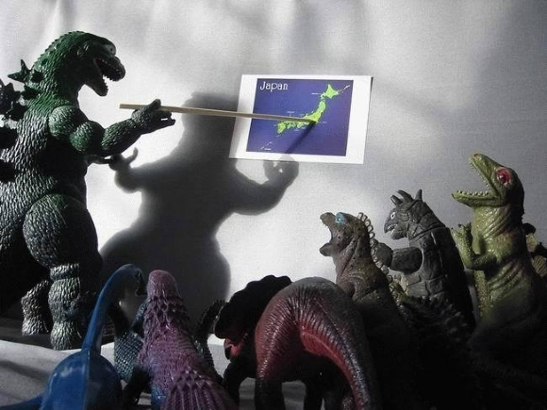
Questions?

