Slide 1
How to Read Practically Anything Faster… and Better!
Paul N. Edwards
School of Information

Slide 2
Purpose and Strategy
Have a purpose
Why you will read
Learn
Integrate (with other knowledge)
Remember
Have a strategy
How you will read

Slide 3
Purpose: key questions
Why was this reading assigned?
Who is the author?
What are the arguments (hypotheses,claims)?
What is the evidence?
What are the conclusions?

Slide 4
Purpose: read critically
What’s missing?
Are you convinced?
What are the weaknesses of the arguments, evidence, and conclusions?
What do you think about them?
What would the author say about these problems?

Slide 5
Purpose: Finish the Job
Always read the whole thing (article, book, assignment…)
Realistic assessment of available time
Decide how much time you will spend
Make a place for reading
Physical
Mental
Schedule

Slide 6
Strategies: Read It Three Times
Overview: discovery
Generate questions
Identify key concepts
Detail: understanding
Answer questions
Identify arguments
Notes: recall and note-taking
Less is more: don’t write too much

Slide 7
Strategies: The Principle of High Information Content
Cover
Table of contents
Index
Bibliography
Preface and/or Introduction
Conclusion
Pictures, graphs, tables, figures
Section headings
Special type or formatting

Slide 8
Strategies: Use the Hourglass Structure
From broad (general) to narrow (specific), and back
General
Specific
General

Slide 9
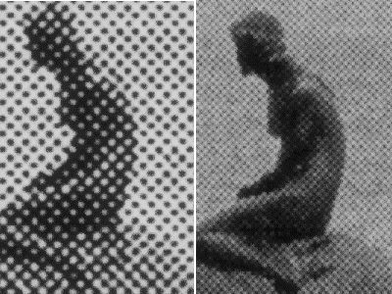
Page vs. Screen
300 dpi
600 dpi

Slide 10
Strategies: Use PTML (Personal Text Markup Language)
Paper
Underlining, highlighters
Make notes in the margins
Fill in missing section headers
Post-Its (color coded; with notes)
About PDFs
Less is more

Slide 11
Strategies: Investigate Authors, Organizations, and Contexts
Authors are people
Background? Politics? Professional position? Friends/enemies? Gender/race/class?
Organizations: cultures, norms, goals
Academia, journalism, mass media
Intellectual contexts
Why write this? To whom?
Debates within academic fields? Political importance?
Who are the authorities? Who are the renegades? Who’s winning, and why?

Slide 12
Strategies: Plan your Time; Use your Unconscious Mind
Study time has an inherent structure
Two 1.5-hour sessions are better than one 3-hour session
Attention drops off after 1 hour
Will power diminishes over the course of a day
Use your unconscious
A lot happens while you’ re not home

Slide 13
Strategies: Rehearse, and Use Multiple Modes
Continue to think about the book/article after you’ve finished it
Use active modes of thinking
Talk
Write
Visualize

Slide 14
Whatever you practice, you get good at…

