Slide 1
University of Maryland
College of Information Studies
Information and technology for good
ischool.umd.edu

Slide 2
About the UMD iSchool
“Expanding the frontiers of how information and technology are accessed and used”
Located just outside of Washington, D.C. the UMD iSchool, faculty, staff, and students together are combining principles of information science with cutting-edge technology to foster access to information, improve information interfaces, and expand how information is used in an evolving world.
As a top-ranked research and teaching college in the field of information science, we are committed to utilizing information and technology for good to:
connect communities
empower individuals, and
create opportunities

Slide 3
Our Vision
We envision a world where information and technology break down barriers and create exciting new possibilities so that individuals, communities, and organizations can explore their full potential and enjoy an enriched quality of life—a world where information and technology can be fully leveraged to solve real-world problems and foster a culture of trust and respect.

Slide 4
Four Strategic Pillars
Support information institutions and infrastructures
Increase trustworthy information
Democratize discovery
Support data and tech for social good

Slide 5
About the UMD iSchool
“We are focused on leveraging information and technology to improve lives of individuals and communities”
1,900
Students across all programs
70
Professional- and Tenured- track Faculty
14
Degree Programs & Certifications
85+
Active Research Projects
$10M
In Research
Expenditures

Slide 6
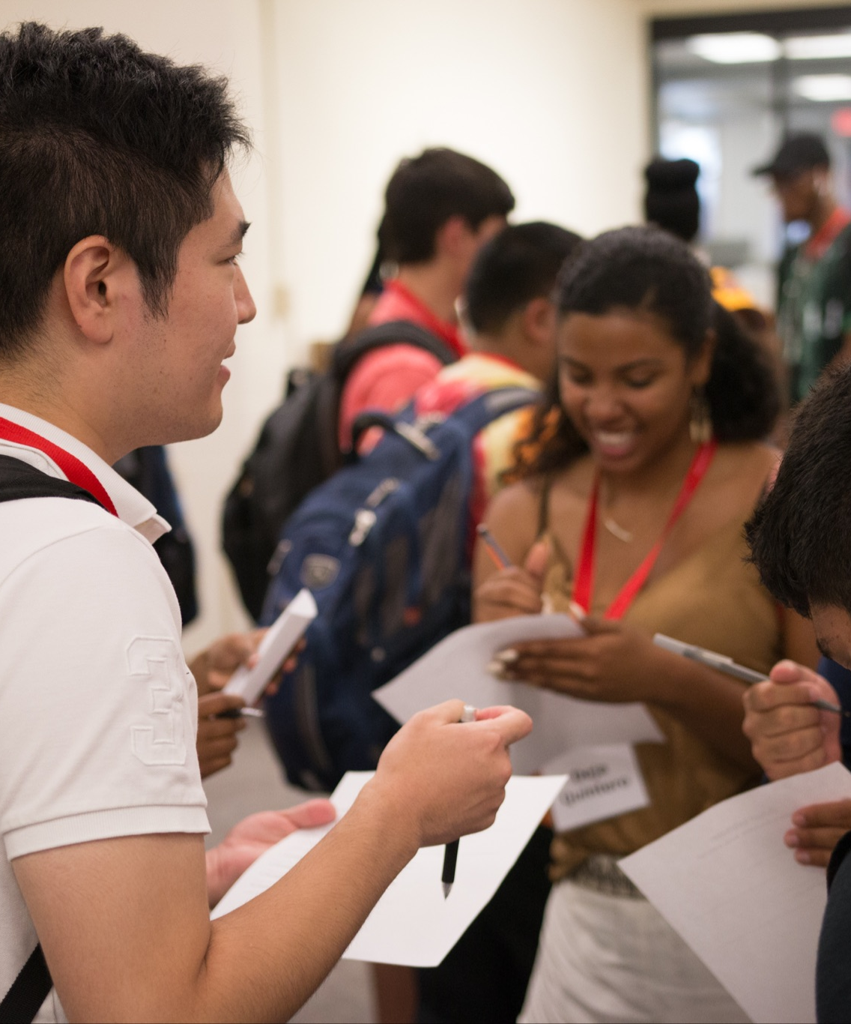
Growth at the iSchool
300% Increase in faculty, staff, and students in last 3 years
BSIS 5th largest undergraduate program at UMD in just 5 years
4 New undergraduate and Master’s degree programs as of 2021

Slide 7
A History of Activism
The UMD iSchool (formerly the UMD School of Library and Information Services) was founded in 1965 with a mission to transform the ways in which libraries functioned in communities – bringing information related to health, housing, education, police and emergency services, consumer affairs, employment, government, and more to underserved communities. In the 1960s, this was a radical and even opposed concept.
The UMD iSchool is credited as having the first library and information science program with a core focus on identifying and addressing the social needs of communities. The college also has a legacy of championing diversity within its own community, actively recruiting students and faculty from underrepresented populations since its inception.
Land Acknowledgement
At the College of Information Studies, we believe it is important to create dialogue to honor those that have been historically and systemically disenfranchised. So, we acknowledge the truth that is often buried: We are on the ancestral lands of the Piscataway People, who were among the first in the Western Hemisphere. We are on indigenous land that was stolen from the Piscataway People by European colonists. We pay respects to Piscataway elders and ancestors. Please take a moment to consider the many legacies of violence, displacement, migration, and settlement that bring us together here today.
The land acknowledgment we use was organized by Ghonva Ghauri from MICA and approved by Piscataway elders.

Slide 8
Diversity in the iSchool Community Today
31%
42%
54
Underrepresented Groups
Female
Student Body
Countries
Represented

Slide 9
Continuing a Mission of Activism
Diversity and inclusion continues to be central to the mission of the UMD iSchool today
Our faculty, staff, and students are actively:
• Collaborating with the National Federation of the Blind to develop and enhance curriculum in areas of diversity and inclusion
• Organizing the annual Conference on Inclusion and Diversity in Library and Information Science (CIDLIS), the first and longest-running event of its kind
• Serving on diversity and inclusion focused boards and committees, such as the Executive Board of the Black Caucus of the American Library Association and the FAS COVID-19 Rapid Response Task Force - Societal Impacts Group
• The Anti-Racist Teaching Seminar (ARTS), now in its second year, helps make our courses and teaching more inclusive, equitable, anti-racist and anti-oppressive by providing a learning community in which faculty and students revise curricula and develop inclusive teaching practices.
• Offering an MLIS specialization in diversity and inclusion (we were the first program to do so)

Slide 10
Maryland Community Support
The UMD iSchool continuously strives to find solutions that benefit the state of Maryland and its diverse communities
Some of our recent initiatives include:
Expanding Wi-Fi Access in Regional Parks - a new $159K NSF-funded project to increase internet access in partnership with the Maryland-National Capital Parks and Planning Commission (M-NCPPC)'s Department of Park and Recreation
Be an Advocate for pubLic Transportation (BALTO) - a collaboration between where a team UMD iSchool, UMD School of Architecture, Morgan State University, and University of Baltimore to develop and deploy a digital toolkit designed to spark community-informed, actionable transportation solutions for eight neighborhoods in Baltimore, MD
Mathletics - a program led by associate professor, Dr. Tamara Clegg, focused on engaging African American and Latinx youth in an effort to deepen their STEM knowledge and introduce them to STEM fields

Slide 11
COVID-19 Initiatives
Faced with the ongoing COVID-19 pandemic across the nation, the UMD iSchool community continues to leverage its global network to develop cutting-edge research and forge partnerships with national and international institutions to combat these crises
Some of our recent initiatives include:
Library Field Guide to Survive Crisis - LIS expert Mega Subramaniam worked alongside 137 library staff across the U.S. to develop a comprehensive digital field guide designed to assist library administration and staff through crises
Faculty Members Join FAS COVID-19 Task Force - Professors Jen Golbeck and Beth St. Jean were selected to join a world-class team of experts assembled by the Federation Of American Scientists to examine and advise on big data and technology issues surrounding COVID-19
UMD, CMU, Facebook Team Up to Forecast Coronavirus Spread - leveraging data shared by more than 30 million Facebook users world-wide to predict the spread and future hotspots of COVID-19

Slide 12
Bachelor of Science in Information Science at College Park (InfoSci)
Fast Facts
#1 Fastest Growing Undergrad Program
Cultivated new research organizations and partnerships to support growing interest in archives and museums, digital curation, libraries, and more
86% career placement rate (2020), with 95% of employment directly related to field of study
InfoSci graduates go on to careers in:
data science and analytics, database administration, UX/UI, technology development, digital curation, cybersecurity, web content and development, systems architecture, and more
Our alumni are working with leaders in information science and technology, such as:
Amazon Web Services, Booz Allen, Deloitte, EY, Freddie Mac, Google, JP Morgan, Oracle, Microsoft, Navisite, and more
30% female student body
72% under- represented groups

Slide 13
Bachelor of Science in Information Science at Shady Grove (InfoSci-SG)
Unique to InfoSci @ Shady Grove, two new minors were launched Fall 2021
Risk Management, Ethics, and Privacy - combines creative leadership, design thinking and understanding socio-technical challenges to tackle large scale problems relating to technology innovation
Technology Innovation Leadership - students learn practical strategies to mitigate risks and explore the ways emerging technologies benefit in the context of risk management, ethics, and privacy
In a partnership with Montgomery County Public Schools, students and faculty at Shady Grove are currently supporting STEM teachers who offer cybersecurity camps for middle school students

Slide 14
Master’s in
Library and Information Science (MLIS)
Fast Facts
Ranked #4 in the USA (U.S. News & World Report)
Cultivated new research organizations and partnerships to support growing interest in archives and museums, digital curation, libraries, and more
Center for Archival Futures (CAFe)
MLIS students work with faculty and industry partners to make archives more accessible to populations who have been historically excluded
Developed new courses in response to important issues facing LIS professions, including:
Roles and Responses to Crisis by Information Institutions
Outreach, Inclusion, and Crowdsourcing
Critical Theory in LIS
82% female student body
72% under- represented groups

Slide 15
Master’s in
Human-Computer Interaction (HCIM)
Fast Facts
Ranked Top 20 HCI Programs in the USA
Students are prepared to create innovative technologies that transform the ways people connect to information through an interdisciplinary curriculum
HCIM graduates go on to careers in:
UX/UI and interaction design
usability analysis, user research
visual design, product design
technology development
technology project management
technology evaluation,
and more
67% female student body
69% under- represented groups

Slide 16
Master’s in
Information Management (MIM)
Fast Facts
1st MIM Program in the USA
Through a multidisciplinary curriculum that draws from management, computer science, information systems, and information science, this degree program addresses the growing and unique need for information professionals who understand complex social and organizational issues
Currently offering seven Focus areas:
Cyber Threat Intelligence, Data Science & Analytics, Game and Entertainment Analytics, Information Risk Management, Smart Cities and Connected Communities, Strategic Management, Technology Development
Some companies our students have partnered with include:
Brookings, Bozzuto, Maryland Center for Computing Education, UMD Urban Studies & Planning Department, and WSSC Water
61% female student body
82% under- represented groups

Slide 17
Dual Master Degree in History and Library & Information Science (HiLS)
Jointly run by the iSchool and the Department of History, this program allows students to graduate with both a Master of Arts in History (MA) and a Master of Library and Information Science (MLIS)
Field study placements help HiLS students find competitive jobs in a variety of institutions as Librarians, Managers, Archivists, and Collections Officers
Our alumni now work in institutions such as:
the Library of Congress
Smithsonian Institution
Department of Justice
National Geographic, and
National Archives and Records Administration

Slide 18
Dual Master Degree in Information Management and Community Planning (CPIM)
Designed to train future professionals with the expertise to create "smart cities" that make use of data and information technology to improve the lives of community residents
Jointly run by the UMD iSchool and the UMD School of Architecture, Planning and Preservation, the program allows students to graduate with both a Master of Information Management (MIM) and a Master of Community Planning (MCP)

Slide 19
Fast Facts
PhD Program
The 2020-2021 academic year saw the largest cohort to date
Alongside the iSchool's brilliant faculty, PhD candidates can pursue the world’s most difficult, unanswered questions about information and tackle today’s critical social problems
Graduates go on to land careers in academia, government, and industry, working with some of the most prominent social and technical innovators, including:
AT&T Labs Research, Facebook Research, Google, IBM, Microsoft, National Library of Medicine, Johns Hopkins Applied Physics Laboratory, and various universities across the globe
65% female student body

Slide 20
New Academic Programs

Slide 21
Master of Professional Studies in
Data Journalism Launching Fall 2022
The UMD iSchool and the Philip Merrill College of Journalism will offer a new “from anywhere” graduate degree program combining STEM data management and world-class journalism
Students will gain marketable skills in data collection and data visualization to communicate meaningful findings
Applications are now being accepted for Fall 2022

Slide 22
Master of Professional Studies in Game, Entertainment, and Media Analytics (GEM) Launched 2021
A fully online graduate degree which addresses the unique need for highly-trained information professionals and data scientists who understand the complexities that the entertainment industries face today
Students learn how to apply analytics and data science methods in support of:
video and mobile gaming
streaming video
Over-The-Top (OTT) media
eSports
traditional media
and more

Slide 23
Certificate of Professional Studies in Information Risk, Privacy, and Security (CIRPS) Launched 2021
The UMD iSchool and the Philip Merrill College of Journalism will offer a new “from anywhere” graduate degree program combining STEM data management and world-class journalism
Students will gain marketable skills in data collection and data visualization to communicate meaningful findings
Applications are now being accepted for Fall 2022

Slide 24
Research at the iSchool

Slide 25
Research Overview
Our researchers combine principles of information science with cutting-edge technology to
foster access to information, improve information interfaces, and expand how information is used
46
$35.3M
6
Active Grants
In Funding
Centers & Labs
14 unique research areas, including the second-ranked Youth Experience specialization in the U.S.
16 funders, including:
NSF
Institute for Museum, and Library Services
Trace R&D Center
Including the:
Human-Computer Interaction Lab (HCIL)
Center for Archival Futures (newly launched in 2021)
Trace Research and Development Center (Trace)

Slide 26
Research Areas
At UMD research centers and labs, we enable discovery, creativity, problem-solving, and fun while tackling real-world challenges and developing impactful solutions
Library and Information Science
Data Science, Analytics, and Visualization
Accessibility and Inclusive Design
Digital Humanities
Data Privacy and Sociotechnical Cybersecurity
Social Networks and Online Communities
Smart Cities and Connected Communities
Information Justice, Human Rights, and Technology Ethics
Human-Computer Interaction
Future of Work
Health Informatics
Youth Experience, Learning, and Digital Practices
Computational Linguistics, Machine Learning, and Information Retrieval
Computational Archival Science

Slide 27
Research Centers & Labs
All students are invited to participate in hands-on research and learning at our six centers and labs:
Advanced Information Collaboratory (AIC)
An international community network of partners interested in exploring the opportunities and challenges of disruptive technologies for archives and records management
Human-Computer Interaction Lab (HCIL)
An international community network of partners interested in exploring the opportunities and challenges of disruptive technologies for archives and records management
Center for Archival Futures (CAFe)
Develops and disseminates human-centered approaches to creating the systems, processes, and institutions which enable the use of and care for digital objects and data over time
Social Data Science Center (SoDa)
An international community network of partners interested in exploring the opportunities and challenges of disruptive technologies for archives and records management
Computational Linguistics and Information Processing Lab (CLIP)
Develops and disseminates human-centered approaches to creating the systems, processes, and institutions which enable the use of and care for digital objects and data over time
Trace Research and Development Center (Trace)
An international community network of partners interested in exploring the opportunities and challenges of disruptive technologies for archives and records management

Slide 28
Trace R&D Center
Since 1971, the Trace Center has helped millions of people interact with the world using common everyday devices, like telephones and computers.
The Trace Center is developing new technologies and conducting research that has the potential to ensure continuous improvement in accessibility, both for end users and for organizations who manage accessibility.
Some of these ongoing projects include:
iAccessible - an automated software tool for digital accessibility compliance testing
Morphic - automatically adjust a computer's settings and special features to the user’s unique specifications, such as font sizes, color contrast, zooming, and screen reading
Inclusive Design for People with Dementia - a project funded by the NSF to improve technology for people with cognitive impairments
Personalized Self-Tracking Tech for Older Adults - NSF-funded project to develop teachable interfaces for wearable technology to enhance the motivation of older adults to engage in physical activities with their own health data

Slide 29
Human-Computer Interaction Lab (HCIL)
One of the first HCI labs in the U.S., the HCIL has a long, rich history of transforming the experience people have with new technologies
We believe it is critical to understand how the needs and dreams of people can be reflected in our future technologies. To this end, the HCIL develops advanced user interfaces and design methodology.
HCIL Symposium - an annual conference that gathers researchers interested in accessibility, AI, computing, co-design, information behavior, privacy and security, and more to discuss and share ideas and innovations

Slide 30
iConsultancy
Through the iConsultancy Program, students partner with public and private sector organizations and businesses to solve their information challenges
Nearly 400 iSchool students, both graduate and undergraduate, completed 90 projects over the 2020-2021 academic year, utilizing skills in UX/UI, data visualization, information management, and database and technology development
Example projects include:
United Way of Lower Eastern Shore - designing a web-based platform to improve overall health and social literacy among the four Lower Eastern Shore counties of Maryland
Library of Congress - revitalizing LOC’s Chronicling America historic newspaper collection to reach new audiences
Cool School - reshaping how the app, Cool School, teaches children about conflict resolution in the modern day
Historic Takoma - implemented a new website design, and developed a full-fledged migration plan and user manual for Historic Takoma’s leadership during COVID-19

Slide 31
KidsTeam
The UMD KidsTeam brings together children ages 7-11, researchers, and technologists to co-design technologies that support children’s learning and play
Because of their long tenure, KidsTeam kids are experts in more than being kids, they are experts in:
collaborating with adults and other kids
prototyping techniques
communicating their ideas
KidsTeam Youth Tech Design research enhances our understanding of intergenerational design techniques and how to build technologies that are more relevant to children’s interests and needs
KidsTeam regularly partners with companies, such as Nickelodeon, to develop or fine-tune products for youth

Slide 32
Info Challenge Est. 2017
UMD Info Challenge, formerly known as UMD Data Challenge, is a week-long data exploration event that gathers teams of students from across multiple academic institutions to work with partnering organizations to:
address real-world problems,
provide valuable team-building experience
network with industry professionals
Partner organizations have included:
Johns Hopkins University, Applied Physics Lab
U.S. Naval Academy
U.S. Department of Agriculture
U.S. Department of Housing and Urban Development
UMD National Center for Smart Growth

Slide 33
Sociotechnical Cybersecurity (STC) Interest Group Est. 2020
Purely technical solutions to cybersecurity are insufficient as they do not wholly account for the complex range of users and environments those solutions must address
The STC Interest Group at UMD was created in response to the U.S. 2016 federal cybersecurity R&D strategic plan which named sociotechnical approaches as the path forward for the cybersecurity of systems and infrastructure
Through STC-focused academics, events, and research, our faculty, staff, and students are pushing the boundaries of thought in STC

Slide 34
Search Mastery Interest Group Est. 2021
Exploring the foundations and practice of search skills, education, and literacy
Search Mastery promotes informed decision-making and problem-solving by increasing the opportunities that individuals have to learn the knowledge, skills, and practices that they need to efficiently and effectively find necessary information
The Search Mastery community at the iSchool is exploring the foundations and practice of Search--skills, education, and literacy—through research, curriculum development, education, and public outreach, including:
Guest lecture series
Developing Search Mastery modules
Public Library Outreach initiative for adult library patrons

Slide 35
Dean’s Distinguished Lecture Series
The Dean's Distinguished Lecture Series provides an opportunity for faculty, staff, students, alumni, and partners to explore current topics related to the college's 14 expertise areas
Led by internationally renowned information science scholars and industry leaders for interdisciplinary academic exchange and productive dialogue, discussion topics have included:
Critical Issues in K-12 Computer Science Education
Democratization of Technology
Reimagining field based science education
International relations in the information age
Societal Effects of Technical System
and more

Slide 36
MEET THE DEANS
Brian Butler
Senior Associate Dean
Mega Subramaniam
Associate Dean for Faculty
Katherine Izsak
Associate Dean for Academic Affairs
Melekte Truneh
Assistant Dean, Finance and Administration
Keith Marzullo
Dean, College of Information Studies
Susan Winter
Associate Dean of Research
Adriene Lim
Dean of University Libraries

Slide 37
Thank You
ischool.umd.edu

